Slide 1
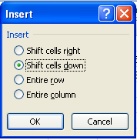
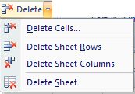
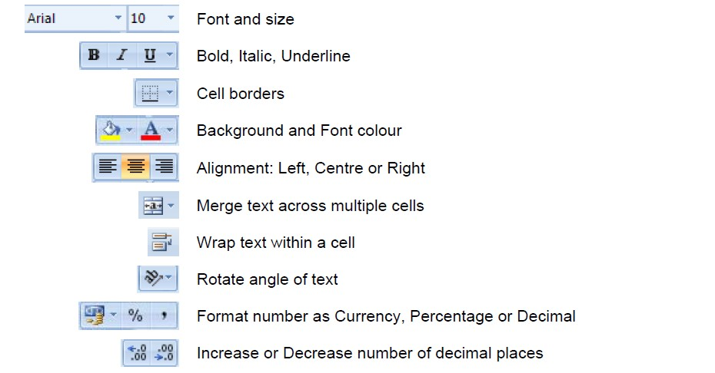
To delete a cell, do as follows:
Select the cell that you want to delete.
On the Home ribbon, find the Cells group and click Delete followed by Delete Cells
Formatting data
Cell formatting
The icons on the Home ribbon provide you with a variety of formatting options. To apply any of these, just select the cell or cells that you want to format, and then click the desired icon.
Commonly used formatting attributes include:

Slide 2
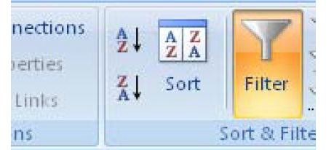
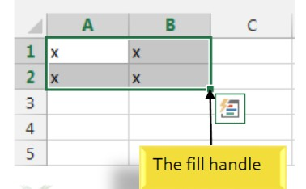
Copying Formulas
Like many things in Excel, there is more than one way to copy formulas. This class will show you some of the methods; feel free to choose which one(s) work
best for you.
To Copy Formulas Using Autofill:
Click in the cell that contains a formula
Position the mouse on the Autofill handle (a skinny black cross will appear)
Click and drag to copy the formula

Slide 3
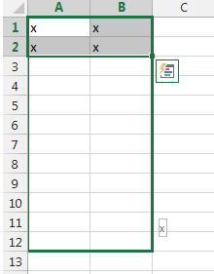
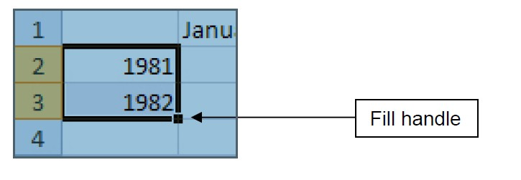
To Copy Formulas Using Copy and Paste:
Click in the cell that contains a formula
Select Copy button on Home Ribbon in the Editing Section
To continue a series with the fill handle
The fill handle can also be used to continue a series. Whenever the content of a row or column follows a sequential order, like numbers (1, 2, 3) or days (Monday, Tuesday, Wednesday), the fill handle can guess what should come next in the series. In many cases, you may need to select multiple cells before using the fill handle to help Excel determine the series order. In our example below, the fill handle is used to extend a series of dates in a column.

Slide 4
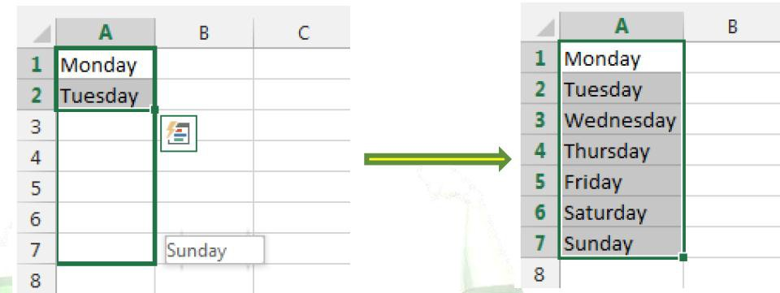
Formulas
Formulas are mathematical equations. There is a list of the functions available within Excel under the menu INSERT function (fx) next to formula bar.
Formulas OR Functions MUST BEGIN with an equal sign (=).
Basic Math Functions
Multiplication Division Addition
= A1 * B3
= A3 / B2
= B2 + A2
Subtraction
= A3 - B1
Formula =A1+A2+A3+A4+A5+A6+A7+A8
Function =SUM(A1:A8)

Slide 5
=SUM(first value, second value, etc)
=Average (first value, second value, etc.)
=Max (first value, second value, etc.)
=Min (first value, second value, etc.)
=Count (first value, second value, etc.)
These operations are evaluated in a particular order of precedence by Excel:
Operations inside brackets are calculated first
Exponentiation is calculated second.
Multiplication and division are calculated third.
Addition and subtraction are calculated fourth.
When you have several items at the same level of precedence, they are calculated from left to right.
Let’s look at some examples:
= 10 + 5 * 3 – 7 (result: 10 + 15 – 7 = 18)
= (10 + 5) * 3 – 7 (result: 15 * 3 – 7 = 38)
= (10 + 5) * (3 – 7) (result: 15 * -4 = -60)
Copying Formulas
Fill Down
1.
select the cell that has the original formula
hold the shift key down and click on the last cell (in the series that needs the formula) under the edit menu go down to fill and over to down

Slide 6
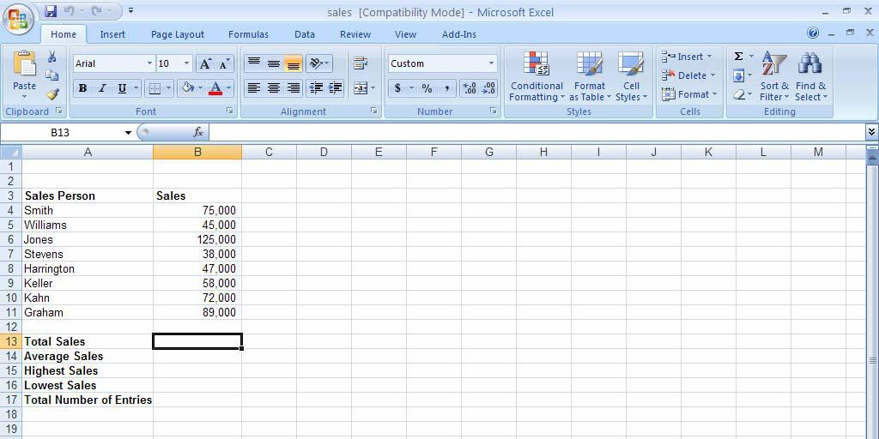
To Enter the SUM Function:
Click in a cell
Type =SUM(
Highlight the range of cells that are to be added (The colon means “through”)
Type a closed parentheses
Press ENTER
To Insert the Average Function into the Worksheet:
Click in a cell
Type =average(
Highlight the range of cells be calculated
Type a closed parentheses
Press ENTER
To Insert the MAX Function into the Worksheet:
Click on a cell
Type =max(
Highlight the range of cells to be calculated
Type a closed parentheses
Press ENTER
To Insert the MIN Function into the Worksheet:
Click on a cell
Type =min(
Highlight the range of cells to be calculated
Type a closed parentheses
Press ENTER
To Insert the COUNT Function into the Worksheet:
Click on a cell
Type =count(

Slide 7
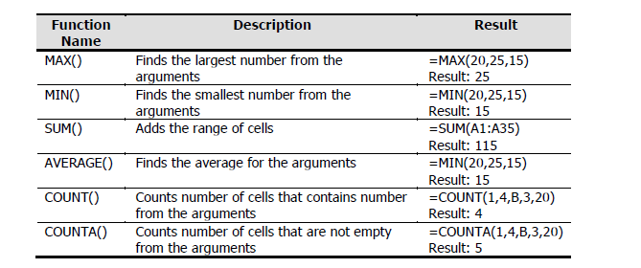
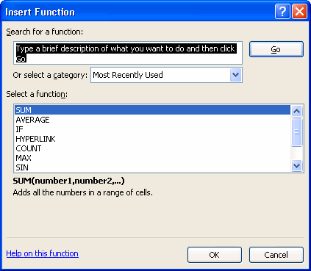
Highlight the range of cells to be calculated
Type a closed parentheses
Press ENTER
Using the Function Library
Excel 2007 contains an extensive library of functions that you can call upon to help you solve problems. These tools are available in the Function Library button group, on the Formulas

Slide 8
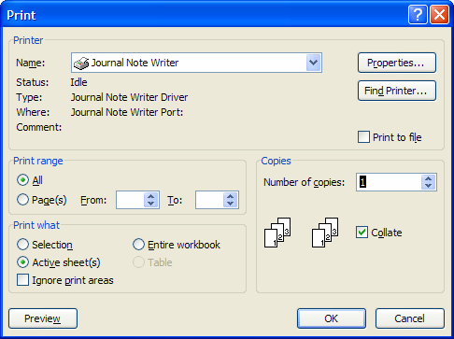
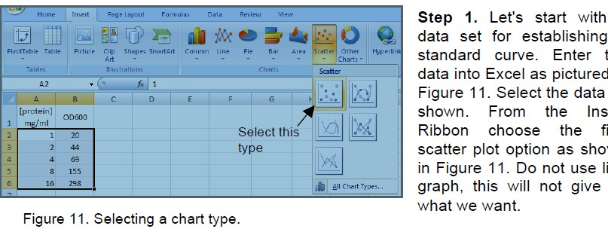
Printing a Worksheet
Open the file you would like to print.
To View the Spreadsheet in Print Preview:
Click on the Office button on the Ribbon
Select the arrow to the right of Print
Choose Print Preview
The spreadsheet shows as it will be printed. You can proceed to print the document from here, or, you can change things to make the printed output looK different
To Print the Document:
Click Print
Click OK
Graphing
The following example will show you how to make a scatter plot, add a linear regression trend line, and how to fine tune the graphs appearance.
Making a scatter plot

Slide 9
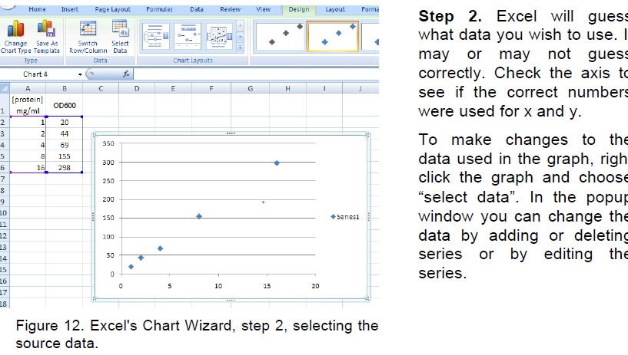
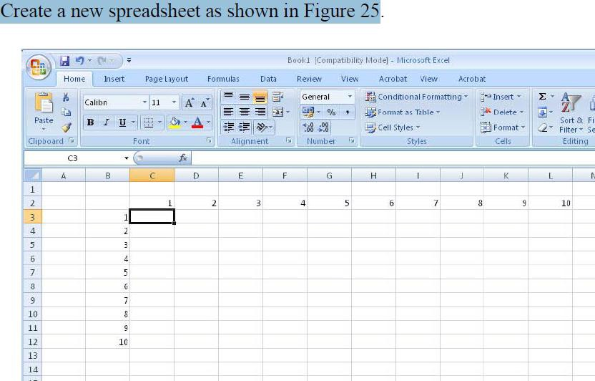

Slide 10
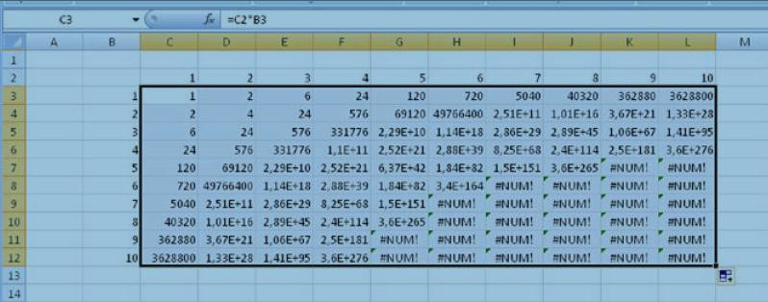
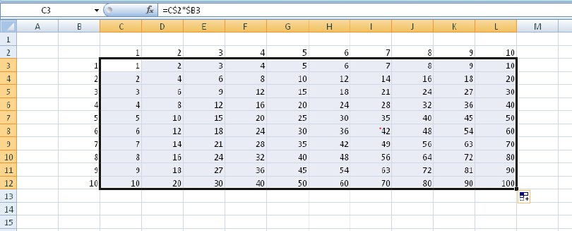
.

Slide 14
arrows and pictures. Each worksheet consists of a tabular grid of cells. There are more than 65,000 rows of cells, starting with number 1 along the left margin of the worksheet. There are 256 columns along the top margin of the worksheet. These columns are labeled alphabetically, using a single-digit and then double-digit alphabetization scheme.
Worksheet Tabs –There is a tab in the bottom left corner of the Excel window for each sheet in your workbook. Clicking on a sheet’s tab will take you to that sheet.

